Slide 1
User Flow(s)

Slide 2
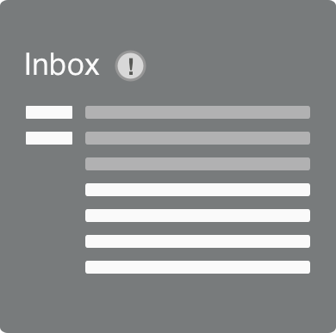
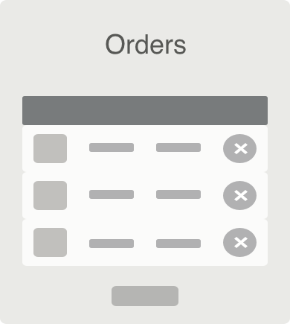
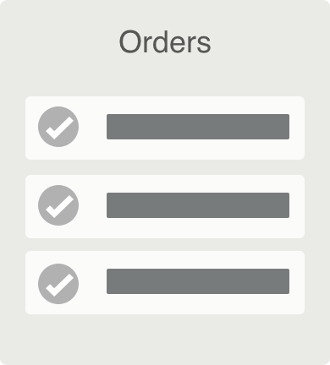
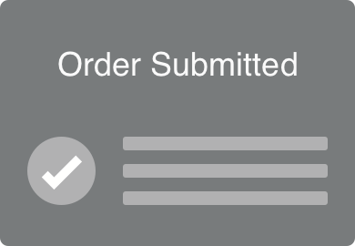
Primary User Flow #1
CMS Employee
“I want to know when my extra monitor will arrive.”
Verify Request Submitted
Checks Approval Status
Checks Arrival Status
Checks Delivery Status
Does
Sees
Confirmation Email
Approval Email
Orders Page
Orders Page

Slide 3
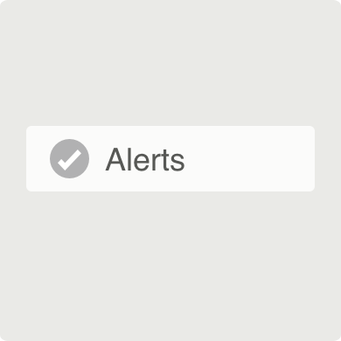
Primary User Flow #2
CMS Employee
“I want to be alerted on the status of my monitor request”
Does
Searches for Order
Clicks “View Orders” Link
Finds Order
Turns on Status Change Alerts
Sees
Confirmation Email
Confirmation Email
Orders Page
Order Alerts

